Slide 1
Laser Cladding for repair for frogs and crossing diamonds
Break through performance
John Haake
President
Titanova, Inc
Presentation with granted permission form Holland
Patent 10,767,318
AMS - austenitic manganese steel or Hadfield Steel

Slide 2
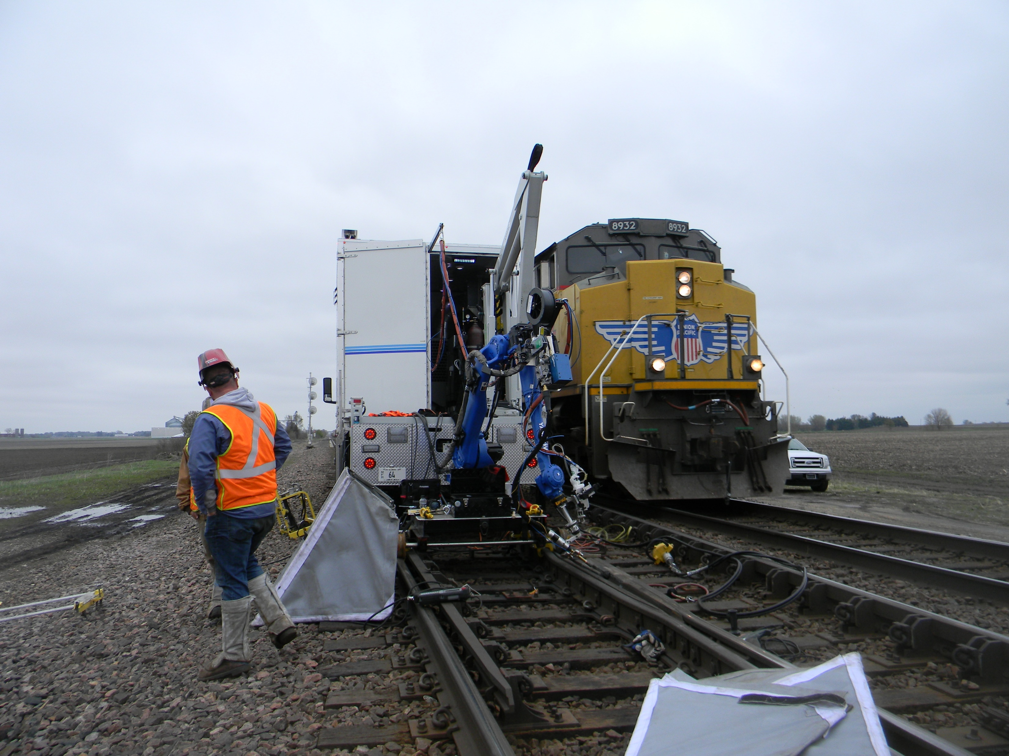
Laser Hot wire Cladding for In-Field Rail Frog Repair Circa 2018

Slide 3
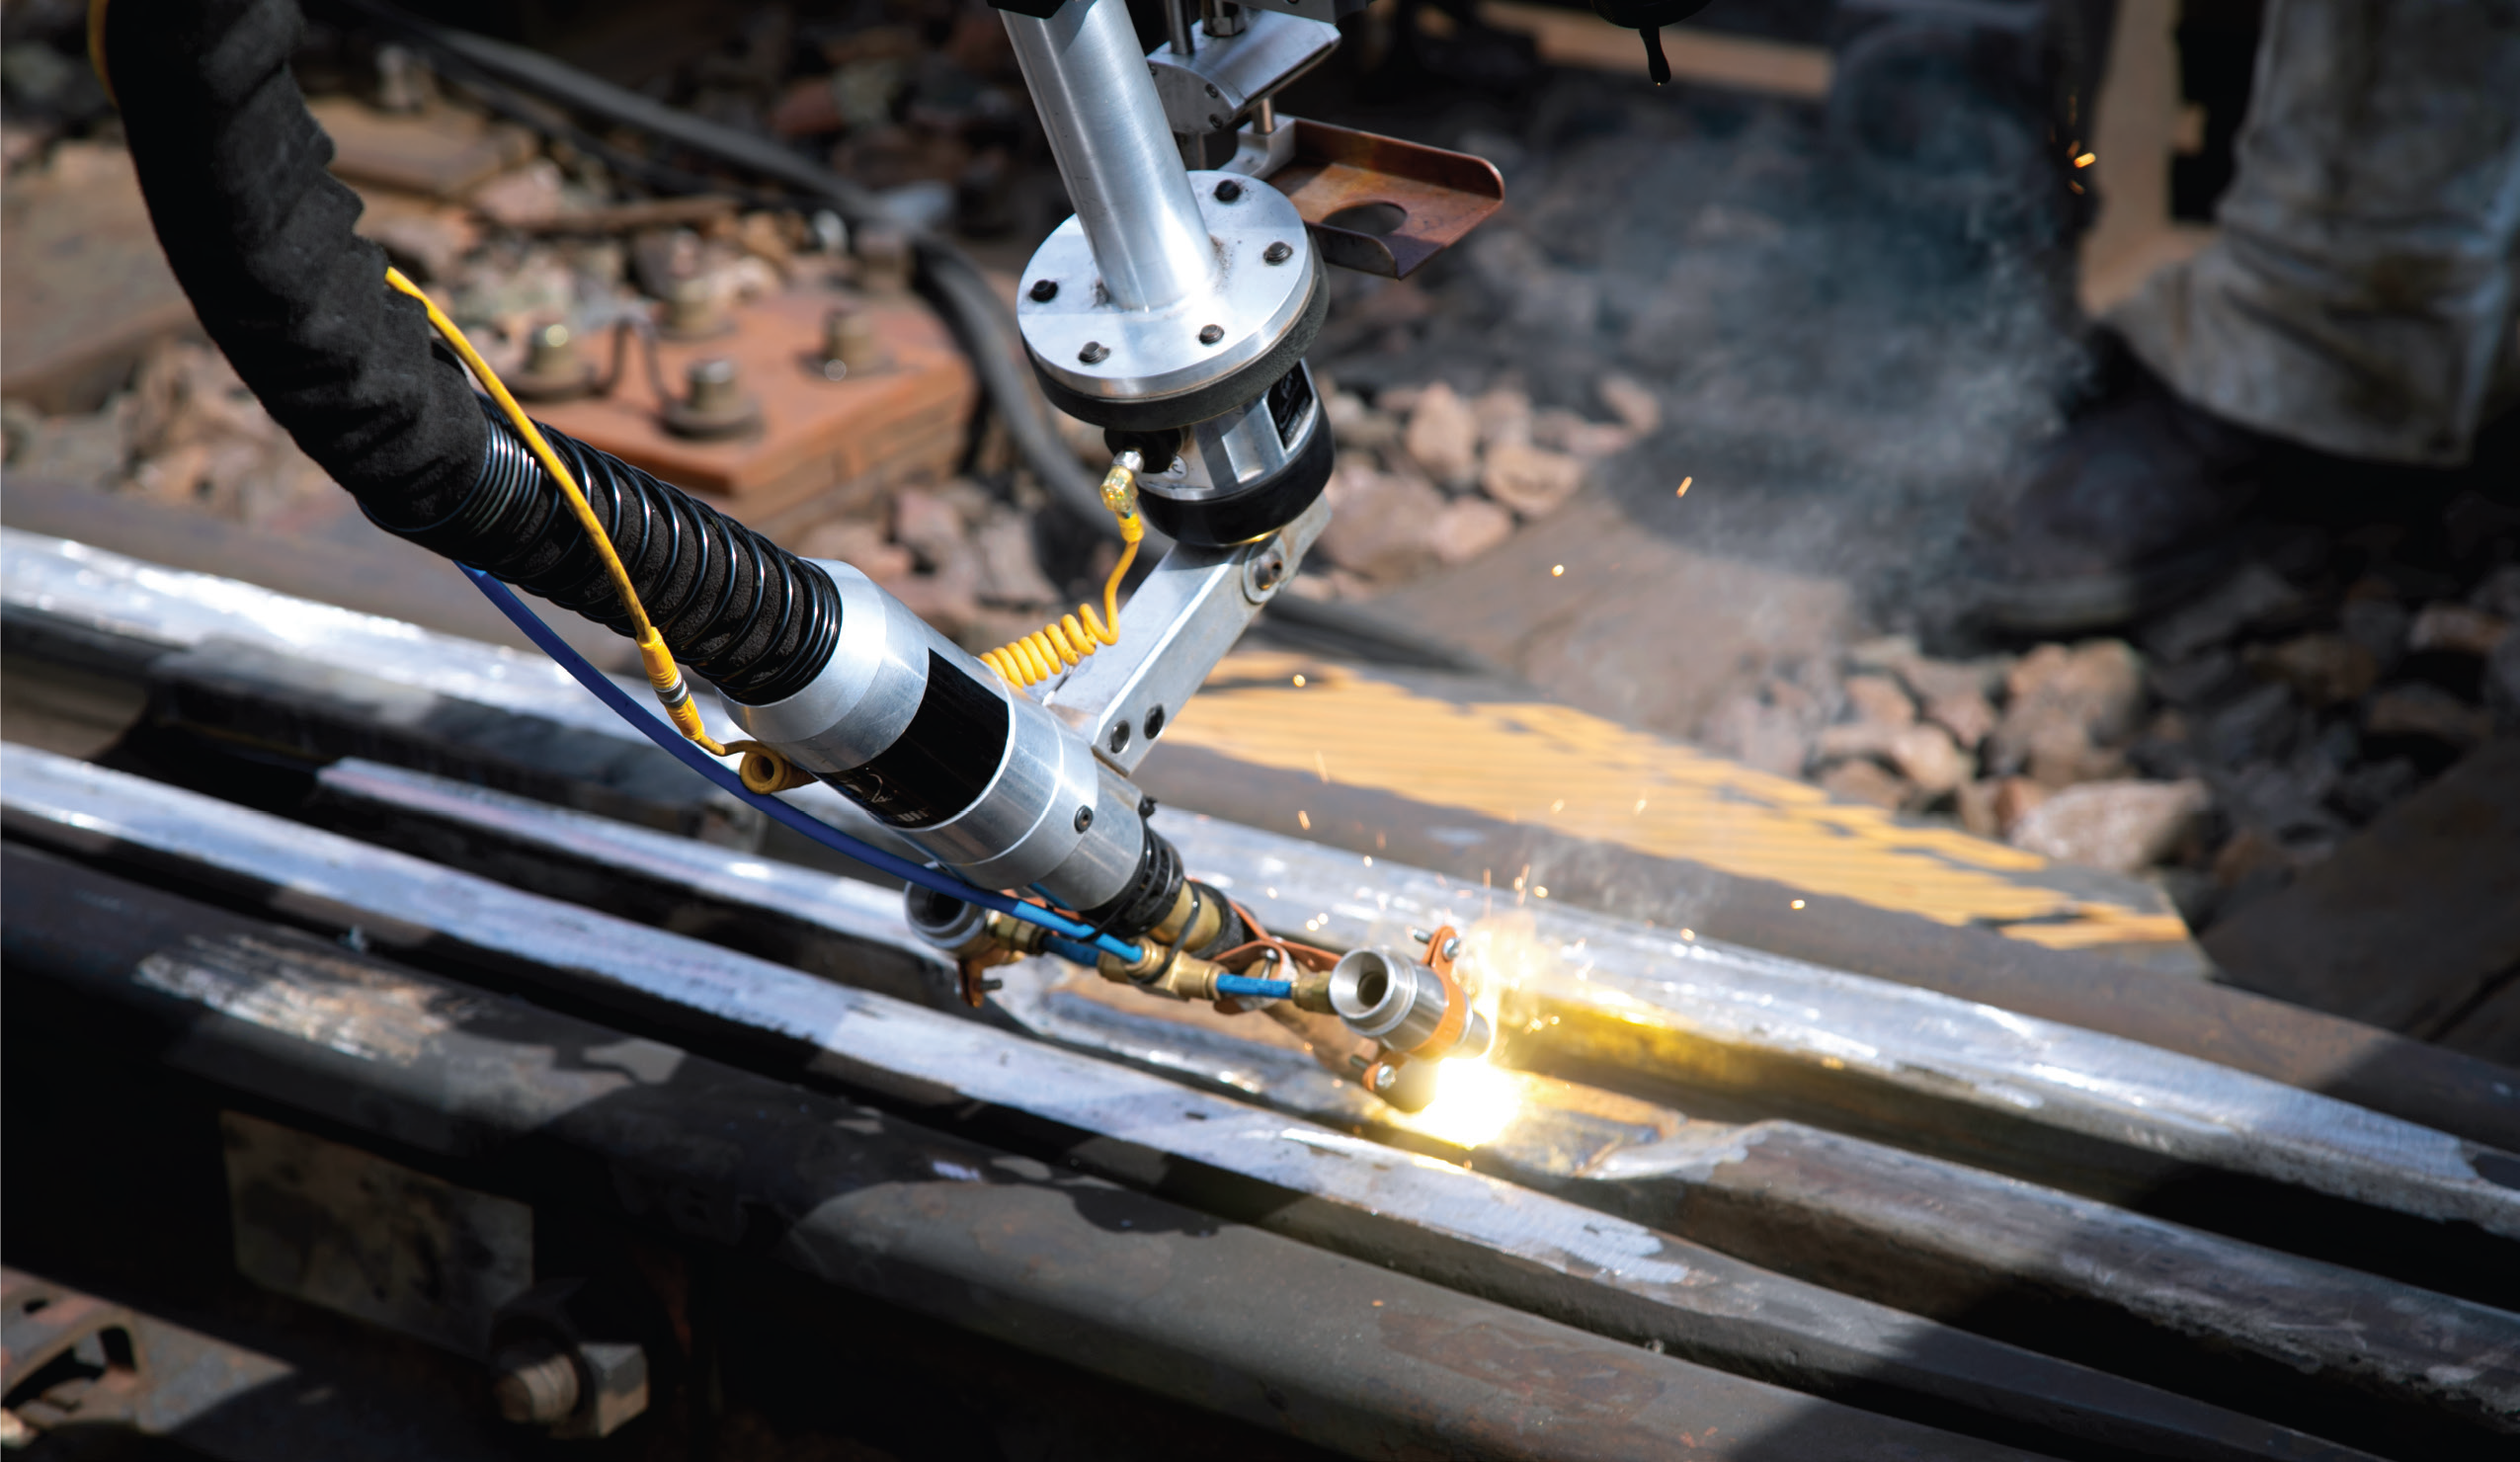
Laser Cladding A.K.A Laser Weld Overlay Benefits for frog repair
#1 Low heat input – less than half traditional welding
#2 High quench rates = finer grain structure = higher toughness
#3 No porosity, no slag = Welded 100% dense
#4 Very low dilution , mixing with base material
#5 Much smoother clads = less post grinding
#6 Near net-shape deposits using powder – No Post grinding?
#7 High deposition rates - 6 – 8 lbs per hours
#8 Robotically Controlled Process – Very repeatable
Demonstrated PRODUCTIVITY
• Material laid down 3-4x faster
than the manual process – No stopping Required for cool down
• Ability to completely refurbish,
in-track or trackside, versus
patch repairs
• Additional money and time saved by
By significant reduction in post grinding
Demonstrated QUALITY
Low heat - base material is always below 500 F
Improved welding process for more precise beads and consistent layers
Lower porosity than traditional methods
No flux required, so no peening for slag removal
Full refurbishment proven to last significantly longer than traditional repair 5X – 6X [ Over 335 MGT demonstrated]

Slide 4
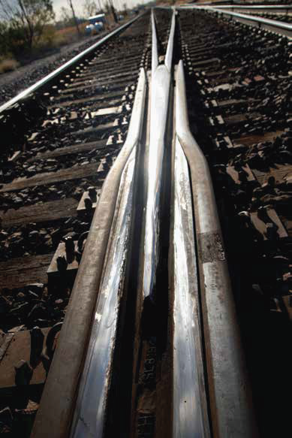
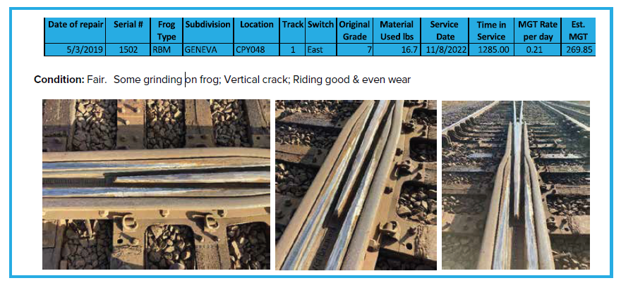
Exceptional Laser welded Frog performance
Union Pacific Laser Hot Wire Welded Frogs [2019] Clinton and Geneva Sub Field inspections 11/2022
15 frogs were inspected in late 2022
• All the frogs inspected have surpassed two to three years of trac
• Minor maintenance grinding will allow them to continue to perform at this level
• The estimated tonnage on the inspected frogs range from 180 MGT to over 250 MGT
at time of inspection for half of the inspected frogs
• As of December 2022, the life of the repairs range from over 2 to 3 years

Slide 5
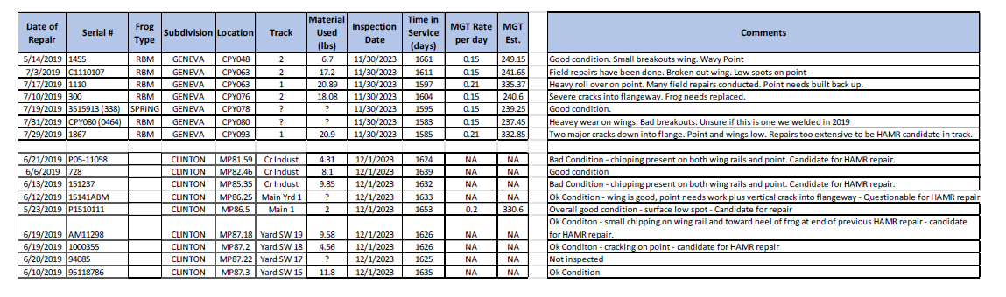
Exceptional Laser welded Frog performance
Union Pacific Laser Hot Wire Welded Frogs [2019] Clinton and Geneva Sub Field inspections 12/1/2023
Holland laser welding welded 43 Frogs in the Clinton and Geneva subdivision between 5/3/2019 and 10/3/2019
Four years after the date of Holland’s original repair there are still 16 frogs in track with 237-335 MGT

Slide 6
Laser Cladding = Significant Cost Savings
Laser Cladding which has the lowest heat input of any welding process has demonstrated break through performance for in field Laser clad frogs
  5 – 6 times more lifetime that traditionally repaired frogs
  Evidence of outperforming new frogs
  Evidence that subsequent laser clad repairs does not further degrade the life of the frog like traditional welding.
Titanova and One Rail Group are working to bring this technology back to the railway
GOALS
Redemonstrate the superb performance of laser clad repaired frogs using powder-based material
  3D cladding
  In situ alloy creation
  Much smoother near net shape = Enabling no post cladding grinding
Implement a Core Exchange program with Traceability
Develop other materials for different track environments [ Wear]
Eventually reimplement in-Field/on-track repair

